Slide 1
DATAVIZ 300 Week : Future of Data Visualization

Slide 2
Guest Speaker Jock Mackinley VP of Research and Design at Tableau Lesson: Fit & Finish

Slide 3
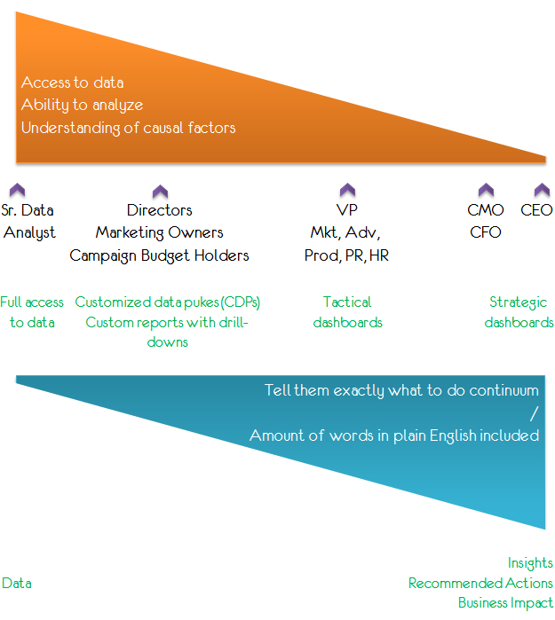

Slide 4
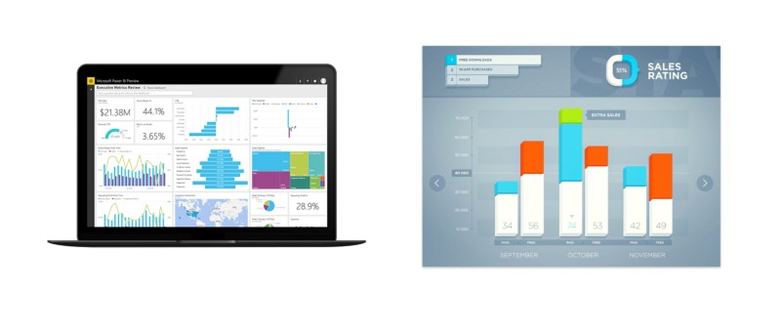
Notes:
In the image above (on the left), the reporting dashboard takes a Mission Control approach to presenting the information…which is pretty overwhelming. To avoid this, we try to approach these types of interfaces bycurating the information more like you're reading a magazine article.
Not to say there isn't a time and place for a mission control UI…I personally would love to design something like that. But for most situations seeing everything all the time is unnecessary.
The key thing to consider — avoid creating a smattering of visualizations.Shape the information on the page so the user is presented with key information first, then follow it up with supporting content.

Slide 5
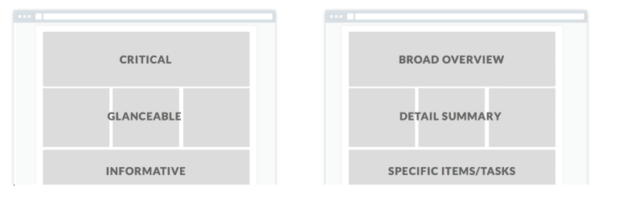

Slide 6
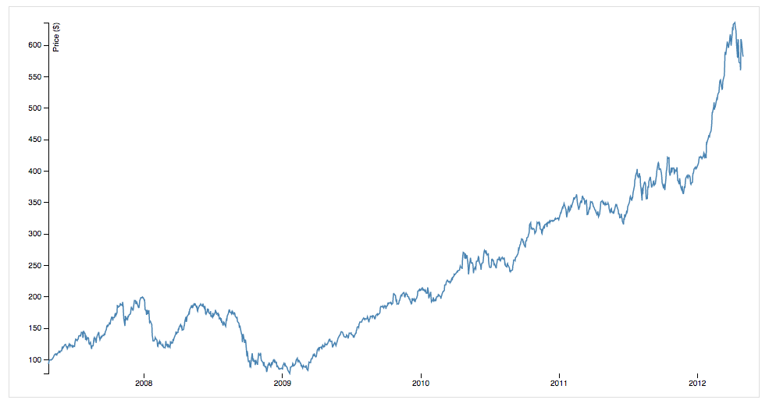
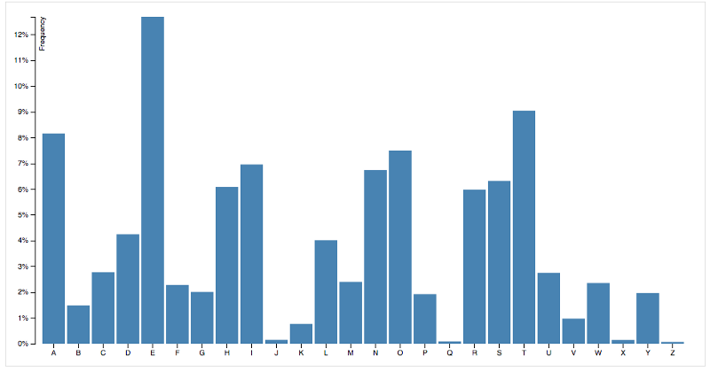
Continuous vs. Discrete
Notes:
Depending on the type of data you're working with some types of visualizations work better than others. One way to choose the appropriate chart is to evaluate the type of data you have. There are two main types of data:
Continuous Data — Any value in a range. For example, rainfall for a season or a person’s height/weight.
Discrete Data — distinct values you can count. For example, a number of goals scored or Facebook likes.
Line graphs work best for continuous data and bar graphs work best for discrete data.

Slide 7
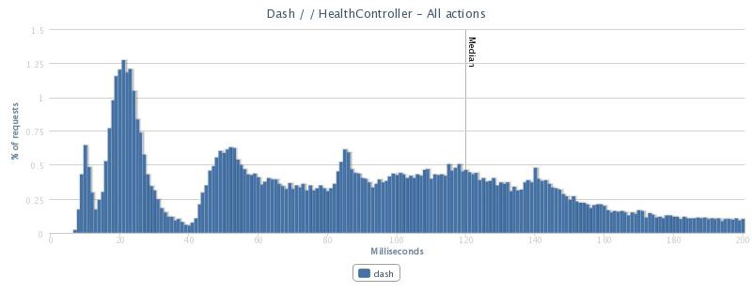

Slide 8
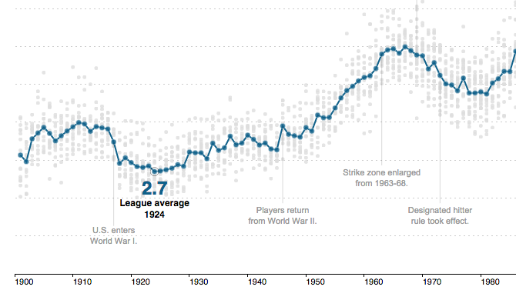
Notes:
http://www.nytimes.com/interactive/2013/03/29/sports/baseball/Strikeouts-Are-Still-Soaring.html?_r=0

Slide 9
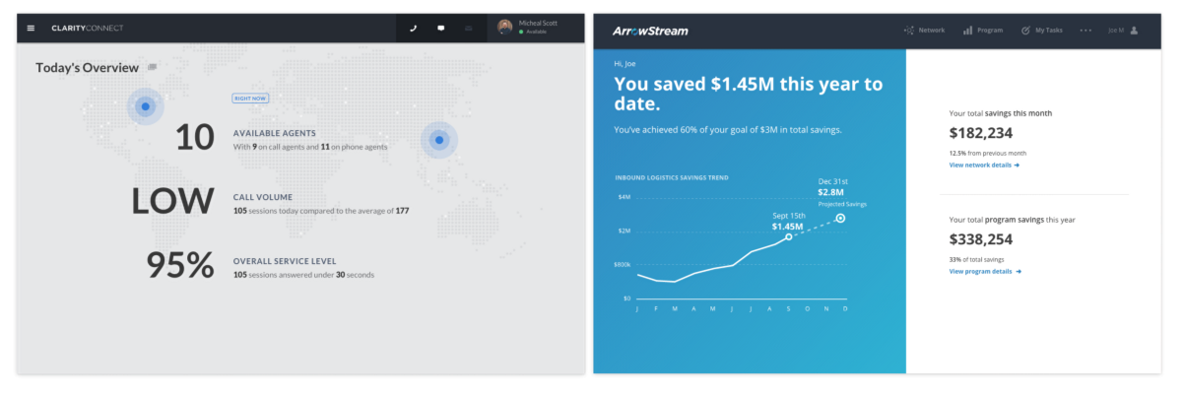
Add Context
Notes:
Both simply tell the user what they need to know via text rather than relying on charts or graphs that need to be interpreted.
This approach resonates with our clients, especially for high-level information. But as I mentioned earlier there are always multiple personas to consider, so use where appropriate.

Slide 10
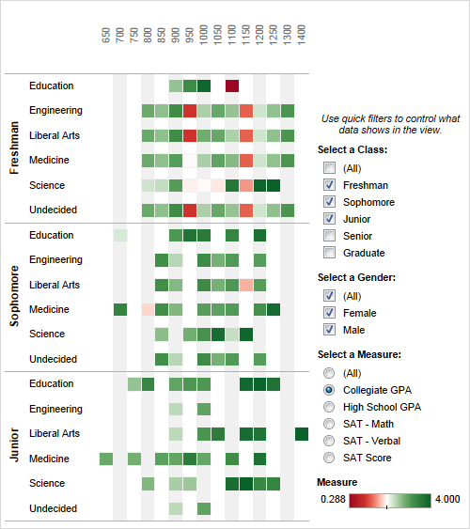
Add Interactivity
Notes:
Turn on quick filters
Quick filters enable viewers to specify which data is shown in the view. To turn on quick filters for any field, right-click the field in the Data window and select Show Quick Filter.
You can customize each quick filter for different types of data. For example, you can show quick filters as multi-select check boxes, single select radio buttons, drop-down lists, sliders, date pickers, and so on. You can also specify whether to include a search button, the option to show all fields, null controls, and more. Finally, you can edit the title of the quick filter to give your viewers clear instructions for interacting with the data. All of these customizations are available on the drop-down menu in the upper right corner of the quick filter card.
Turn on highlighting
Use the Highlight button on the toolbar to set up highlighting between views. When highlighting is turned on, a selection in one view will highlight related data in the other views. You can turn on highlighting for all fields or select specific fields.

Slide 11
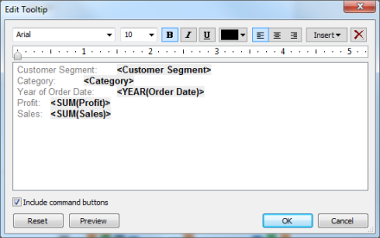
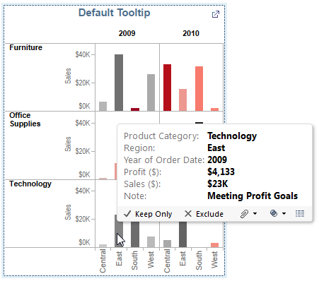
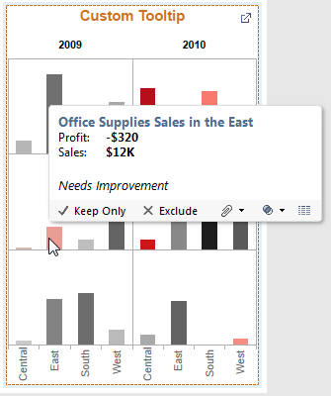
Customize Tooltips

Slide 12
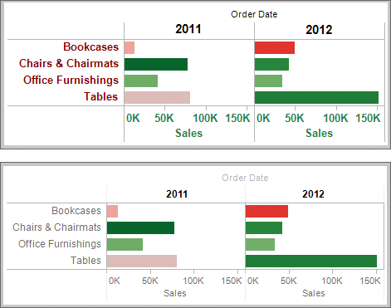
Minimize distractions
Notes:
Be careful to not let axes, labels, and formatting distract the view. Try a smaller font size and lighter text color to de-emphasize labels and let the data shine. Or format divider lines and borders to support the layout and data view type.
In the following image, you can see in the top view how text that is prominent and formatted in the same color and intensity as the bars clutter the view.

Slide 13
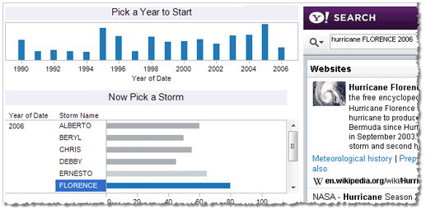
Make statements with titles and formatting
Notes:
If your dashboard has one main view with several details, consider using formatting to illustrate the hierarchy. This technique is useful particularly when you are building a guided analytical experience, in which views are hidden until a selection is made.
Use formatting as a visual aid to draw attention to the view rather than distract from it. To change the shading and border right-click a title and select Format Title. Double-click the title to open it in a rich text editor, where you can fine-tune the color, font style, and alignment

Slide 14
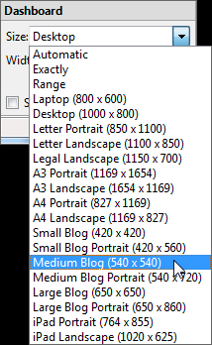
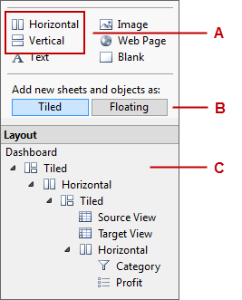
Control the sizing and layout
Notes:
Consider how your dashboards will be viewed. Are you embedding them into a web page? What size screen is your audience using? Here are some tips for controlling dashboard size and layout.
Take advantage of dashboard objects and settings
To fine-tune the layout of a dashboard, you can do any of the following:
Use horizontal or vertical layout containers to group related objects. To use them, drag them from the Dashboard window (callout A above).Items in a layout container align and flow together when the dashboard is resized. You can also nest them. In the Layout pane, expand the nesting hierarchy to see the dashboard structure (C).
Determine whether you prefer components to tile in a fixed position in a layout container or float independently (B).As of Tableau 8.0, you can set objects to floating and position them in specific locations, including overlapping them.
Objects also provide ways to add independent text, images, and web pages to the dashboard.
To learn more, see Tiled and Floating Layouts and Adding Dashboard Objects in the Tableau Desktop Help.
Use Fixed Size Dashboards
Automatic sizing on a dashboard means that when the window is resized, all of the objects in the dashboard are resized too. When you share a dashboard with others, you can change this behavior so that it remains at a fixed size regardless of the size of the window.
When you are considering this choice, think about who will be viewing the dashboard and where. For example, if you are embedding it into a blog or a webpage, you probably know the width and height allowed by your page template.
Change the size of the dashboard at the bottom of the Dashboard window. You can select a standard size from the drop-down list or type a specific pixel height and width.

Slide 15
Like all forms of design, it’s a balancing act. Strive to present your data in a distinctive way, but avoid over-designing and unnecessary distractions. Choose the right graphs for your data, but don’t forget to construct your page with hierarchy. Choose the right graphs for your data, but don’t forget to construct your page with hierarchy.

Slide 16
Notes:
My heart would sink. The candidate would say, “In 2010 Profits surpassed Revenues.” I’d try to keep the frustration out of my voice as I asked, “Do you think it is realistic to expect a company to bring in more profit then total revenue?” The candidate would stare at me. Another bust. 2 minutes in and we’re ready to end the interview.
More often then not, we walked out of the interview and would say to each other, “I just don’t know. I mean he didn’t do anything wrong per se, but I’m just not sure I can send him to work with a customer.
Then occasionally, every once in a blue moon, the candidate would stand up at the front of the room, open tableau and I would see something like this:

Slide 17
Notes:
The visualization was a work of art. He or she would launch into his analysis of the data. It was nuanced. Insightful. Statistically correct.
I would ask, those famed words, “what are your expectations around compensation?” and the candidate would quote a number substantially higher than my max budget. Sigh.
So my counterpart who hires for the Central United States wanted to add Tableau as a required skill to the job description? I honestly wasn’t sure why I was against the idea when he first brought it up. So like any good Tableau user, I went to the data.

Slide 18
Candidates with Tableau Skills
Notes:
My first question was what percentage of the applicant pool to BI jobs, had Tableau as a skill they would list on their resume? How many candidates would we be missing out on if we added it as a requirement. Our friends at Payscale were kind enough to help us out with the data.
If we backed this all the way back to 2001, it would show there was exactly 1 user. His name was Chris Stolte and today he is the Chief Development Officer at Tableau. We made our first then our second sale in December 2003 and a year later had 27 customers. That number grew, and by the end of 2011 nearly 7,000 companies were using Tableau.
This translated into 3 in every 1000 applicants to BI positions having Tableau on their resume. It didn’t change much in 2012.
Then we started to see growth, 6 in every 1000 in 2013. Then something interesting happened. In 2014, it was more than 1 in every 500. This year, its 1 in every 200.
In some roles like Business Intelligence Analyst, that number has reached 1 in every 75. But that means we are excluding 74 potential candidates.

Slide 19
7
%
Notes:
But there were people out there with Tableau. Still not a ton, but enough. So I went back to our friends at Payscale to test a second hypothesis. Holding all else equal, years of experience, job title, location, did Tableau as a skill net candidates a higher salary? The answer was yes, to the tune of 7%. Remembering this is an average, so if I was going to require Tableau as a skill, I needed to be prepared to pay up to 10% more to hire the same applicant with Tableau Software as a skill relative to all workers with the given job.
I’m not going to go into more detail around salaries, but Payscale has amazing salary profiles on their website if you are interested in data to set salaries.
This 7% figure was interesting. I was left wondering was someone with Tableau on their resume really worth 7% more. Tableau is a buzz word in the BI industry currently. Was simply claiming Tableau skills enough. And Tableau is teachable. We designed the product for anyone to be able to use. We fundamentally believe that anyone can learn Tableau. Plus, Tableau as a company has tons of free resources and great training programs. We had to ask ourselves, what were we hoping to accomplish in adding Tableau as a required skill to the job description?

Slide 20
Traits
Skills
Experience
Intangibles
Notes:
A typical interview process approaches hiring with the idea that if you can validate skills, and someone has previous experience we can mitigate the risk that they will do poorly in the job. The brutal truth about hiring is that standard interviewing questions that attempt to get at skills and experience are fatally flawed.
Ask candidates about their prior experience, and you'll discover whether they can articulate what happened around them at other jobs. Ask them technical questions, and you’ll uncover their ability to regurgitate knowledge. Make them solve a 'toy' problem on a white board, and you’ll discover how quickly they solve toy problems. A candidate that passes all of these hurdles with flying colors may be completely ineffective at using Tableau.
When it comes to hiring talent, most companies prefer to “buy” instead of “build.” I often hear: “We only hire people who can hit the ground running.” Leaders of these companies argue that hiring experience reduces training costs while allowing the company to gain outside perspective. But experience alone is not a sufficient predictor of who will be successful in a given role.
Unfortunately, a good deal of what makes someone successful can be mislabeled or misunderstood. For example, having deep knowledge and experience in a particular discipline does not directly correlate to your success as a BI analysts within that industry. Too many times, companies hire based on foundational skills that can be easily taught or knowledge or experience that can be transferred or accumulated, rather than a personality or unique ability that will truly impact the organization.
So often our Interview process is designed to validate Skills, then Experience, than intangibles. Skills are trainable. Experience = we look for. The intangibles are actually identifiable.

Slide 21
Traits can be identified through behaviors.
Notes:
By the time one is eight years old, the neural pathways in your brain become set and the paths you don’t use start to fade. This solidifies your personality and who you are at your core. Traits are a descriptor for the behaviors inherent to you. They are not things that can easily be taught. Its why it is very hard to train people to their weakness. Theses are the things we interview for.

Slide 22
Past behaviors indicate future behaviors.
Focus on getting candidate to tell you stories.
Then interrogate their story.
Notes:
We do this through Behavioral based interviewing.

Slide 23

Curious
Problem Solver
Innovator
Self-Motivated
Situationally Aware
Detail Oriented
Driven to Mastery
Coachable
Passionate
Desires to Help Others
Takes Initiative
Notes:
It doesn’t work if you ask: “Tell me about a time you were curious.” No. You have to ask a question like: Tell me about a project that sparked your interest in a new technology. Why did you become interested and what actions did you take to learn more about these technologies?
We tried at this for a while and weren’t successful. It wasn’t until we designed scoring rubrics for each question that we began to find success.

Slide 24
5
Curious by nature, constant pursuit of knowledge
Enjoys being pushed outside comfort zone
Sets goals and practices to get better
Self Directed, Takes Initiative
Engages growth opportunities when directed.
4
3
2
1
Notes:
The brilliance of this is that we are a data company. By designing a rubric we were able to compare candidates against each other, and note trends over time. It also allowed us to compare all candidates together regardless of who was performing the interview.
We ask multiple questions to try and frame a holistic view of who they are as a person. We actually have a whole 60 minute interview dedicated to this.
The thing about the rubric is it allows anyone to give this interview, opening up the possibility that anyone one my team can take this interview. In fact, I require that every person on my team engages in our hiring process in some way.

Slide 25
Candidates with Tableau Skills
Notes:
For every 1 worker with Tableau as a skill in 2011, there are now 20. This is extremely promising. But our barometer for Tableau as a skill has changed. The product has grown there are new features, are all Tableau experience equal?
Often what I hear from customers regarding their staffing needs is… I need someone who is fast thinking on their feet, can be trusted to interact with high level stakeholders, can take charge, navigate politically, takes feedback and soothes IT. They need to be great with Desktop, tune Tableau Server, design statistical models and build beautiful dashboards. When I hear this I think, you don’t need a Tableau consultant. You want a Unicorn.

Slide 26

Notes:
I hate to break it to you. Unicorns are rare. Nor do we want unicorns. Great teams are built from diversity. Different qualifications, backgrounds, and experiences are important for effective problem solving and also for creating an enjoyable place to work.
So how do we find the right person to be successful. Take a moment to imagine what type of work you need your candidate to do.

Slide 27
IT
Strategic
Business
Tactical
Notes:
Do they work primarily with IT or do they interact with Business Users? Is the work they are doing tactical (like building dashboards or managing Tableau Server) or more strategic (making sense from large quantities of data to drive business decisions or working with your executive team to create a more data driven organization)?
What’s the best way to identify where someone sits on this grid? Simply ask them. Yes, you run the risk of them giving you the answers they think you want to hear. But you can lay the ground work that your team has multiple roles and all answers are acceptable. Remembering that past behavior is the best indicator for future behavior, ask them to give you an example about how they have done that in their previous role.

Slide 28
IT
Strategic
Strategic
Solutions
Integration
Business
Business
IT
Implementation
Analysis
Tactical
Tactical
Notes:
So how does this translate? Is they are doing work around analysis, they likely are in the bottom left quadrant. Integration work around server and data is likely on the right side. Creating solutions to business problems is likely in the upper left.
You can validate this further by looking at their education background:

Slide 29
IT
Strategic
Strategic
PMP
Science
Information
Systems
Mathematics
Business
Business
MBA
IT
Computer
Science
Economics
Business
Tactical
Tactical
Notes:
On our team we focus on Science and Business based degrees. The value of the scientific method, of building a hypothesis and testing are pivotal no matter where in the product you are touching. Server Admins need to troubleshoot problems, rolling out Tableau to an entire organization takes iterative learning, and analysts must ask questions and test hypothesis. There are plenty of people out there who are smart and have a liberal arts background. But you want to make sure that their liberal arts program had lots of qualitative reasoning and they are confident with numbers.
Let’s align this to Tableau’s products and the specific experience you are seeking:

Slide 30
IT
Strategic
Drive
APIs
Business
Server
Desktop
Tactical
Notes:
One day we had a revelation. Wouldn’t it be nice if they could do the job as a trial. We had always had a product demo in our interview, in fact you can’t get hired at Tableau without one. But instead of them coming to present we asked them to send their workbook in advance – as the next step from the traits interview. This allowed us to get a true assessment upfront about what their skills in Desktop really were.
You can then validate this experience with a simple question “I’d love to hear about your Tableau journey. Would you share with me how you’ve gotten to where you are with Tableau and where you want to go?”
In addition to the actual products, I listen for 3 thing:
#1 - Did they have an ah ha moment with the product? Do they get it is different than other BI tools?
Dig in deep here if they have other BI tools on their resume. Its important to align their sense of self-service analytics to where your organization is going. We rarely higher directly from our competitors because they often just don’t get the way Tableau is different. Its not about using the product to create reports, it about iterative question asking, the speed at which it happens, and the opportunity this opens for an individual or a company.
#2, How did they learn Tableau?
Self-Study is good (can be great even) – but drill in. Which blogs do they follow? Do they know what a Zen Master is? How do they keep learning? Are they part of a user group? Do they spend time on Tableau’s forums?
Taken Tableau Training Courses or work with Professional Services is better. We run versions of Fundamentals, Advanced, Visual Analytics, and Server Comprehensive to all of our new hires. Recently one of our Principals who has been using Tableau for 5 years went through the courses and told me he learned things he hadn’t know about the product.
Become certified in Tableau’s Certification Program is best. Tableau’s certifications are tough! They mean something.
What is their passion towards Tableau?
Passionate people will have a thirst for knowledge and be driven to mastery. They will take initiative and see opportunities to use Tableau that other’s won’t recognize.
The question I ask, my favorite question to ask is “What question with any real or imagined data source would you want to use Tableau to answer?” While their answer is interesting, listen to their voice. Does it raise an octave. Do they speed up their words? Are they excited?

Slide 31
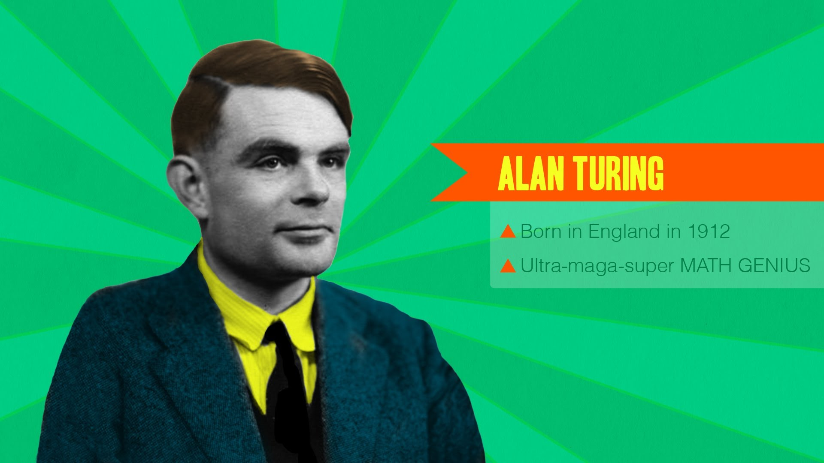
Notes:
Alan Turing. Inventor of the Computer. Ultra-mega math Genius.
The British government hired him in the 1930s to break the code of Enigma. The German Nazi’s crazy code machine.
To do this he needed assistants and he wasn’t pleased with the one’s provided to him. So he envisioned a way to recruit smart people who had great problem solving traits.
He published a crossword in the paper, and invited anyone who solved it to come interview for a super secret job. But instead of a traditional interview, he envisioned something different, let’s watch.

Slide 32
IT
Strategic
Set the
Tableau
Vision
Pull in additional technologies.
Data or Platform
Recommendation
Business
Every project
uses Desktop
Analyze and tell a story with Data.
Tactical
Notes:
What this clip so aptly illustrates is the bias’ in our interview processes. Candidates who would be top performers may fail a traditional interview process. The culprit is interviewer bias. As soon as you enter the room with a candidate, you begin forming opinions (mostly unconscious) about their abilities. There are a wide array of such biases but the most common bias in interviewing is to prefer people who are similar to ourselves.
One of the candidates Turing recruited was a woman named Joan Clarke, who became a very close collaborator. Joan was incredibly talented, but given the biases of the time, would almost certainly have been overlooked for a role on a code-breaking team had it not been for Turing’s scientific approach to hiring.
Just like in The Imitation Game, we put candidates through a sequence of experiences that approximate their potential working environment and evaluate their skills on problems that are highly predictive of their success once we hire them. Surprisingly, with the right planning and investment upfront, this can be done even more efficiently than in traditional interviews, and spare your team’s time.
Our projects have two parts. 1) Every project requires an analysis of data in Desktop.
Align the project to your needs. If you’re analyzing Business data, use a business data set, if you’re hiring a server admin pull data from your server repository on usage.
Note: you don’t want to include any proprietary information in your data set, because it will get shared.
2) Part II is focused on supporting skills. This can take the form of one of four additional pieces. I use the project as an opportunity to not just validate what they have done, but where they want to go and what they want to do? You can use this as an opportunity for a double click down. Ask them to use specific features of the product in their demo, which we will get to in a moment. We meet with each candidate to develop a project that is right for them to showcase the skills they bring to our team. In our case each candidates demo is going to give them a slightly different flavor of a presentation. That is alright. Or you can divise one demo for a position and have each candidate respond to it.

Slide 33
IT
Strategic
Web Data
Connector
Javascript API
Drive
Framework
Extract
API
Canvas
R-Stats
Storypoints
Business
REST API
Tabcmd
Table Calcs
Fit & Finish
Architecture
Calculations
Tabadmin
Tactical
Notes:
Have a dialogue with the candidate about what they want to learn and master next. You’re going to find more people with Desktop experience than anything else, can you leverage that to include APIs or Server if that’s what your organization needs? Use the final opportunity to grow them and see how they respond.
You can do this by asking them to use the supporting technologies they know.

Slide 34
IT
Project
Management
HTML
Java
Strategic
Python
Executive
Briefings
Ruby
C+
Splunk
Salesforce
Stakeholder
Management
Big Data
Schemas
R-Stats
SAS
Statistics
Cubes
Relational
Databases
Storytelling
Business
Industry
Knowledge
ETL
Scientific Method
Load
Testing
Design
Aesthetic
Governance
PowerShell
SAML
Calculus
Analytical
Reasoning
Visual
Best Practices
SQL
Platform
Tactical
Excel
Functions

Slide 35
Notes:
How do we know we are on the right course with a candidate? When we start referring to them as the “Next Abhishek Singh” or they are a mix of Janet Shen and Rowena Lei.
So I want you to bench mark for you some examples of rockstars:
System Administrator – Abhishek Singh – Came from an IT background with 10 years in Higher Ed. He joined our team with a Drive for Mastery, he has since become the leading expert on our team in Salesforce integrations with Canvas to embed Tableau visualizations directly into Salesforce, something he hadn’t worked with previously and we didn’t even know existed as a concept when we hired him.
Solution Innovator - Zach Ahrens –Zach showed more initiative than anyone else I have ever interviewed. He was curious and bitten by the Tableau bug. He was inspired from his first interview and took off more than he could chew with his capstone project. He showed up for the interview and his hypothesis was unproven and his dashboard didn’t work. But his ability to explain to me his project, where he went wrong, and what he would do differently next time reassured me about hiring him.
Business Analyst – Janet Shen – She is the Table Calculations queen. She joined our team from Technical Support with a strong background in troubleshooting. But what set Janet apart was not her mad Tableau skills but her deep desire to help people. On more than one occasion we have heard from someone Janet met while travelling who she helped solve a Tableau issue even though they were on a plane, a train, in a bar, and not even at the office.
Dashboard Creator - Rowena Lei – Rowena was the first person on our team with a business degree and not a science based degree. We hired her because she was smart and driven. We also hired her because she has a fashion blog and she presented beautiful visualizations. Rowena is our go to person for building kickass Executive Dashboards. She can understand the business problem and translate that into the best visual way to tell a story.
Strategist – Ben Schossow. Ben is one of the few on our team that had previous Tableau experience running a small deployment of 30 users. In our interviews he expressed an interest in growing his company’s deployment faster and we’ve seen him rise to the occasion when given the opportunity to work with a multi-billion dollar company. Since joining our team he has become an expert is setting and executing a transition to a data driven culture.
Data Strategist – Paul Shim. Paul was cool, calm, and composed during his interview. His capstone project was an automation project for Tableau Server. Recently a project requirement got lost in translation from Powershell to Python. Paul didn’t break a sweat and was willing to spend the weeks leading up to the project learning a new coding language.
Data Scientist - Lovekesh Babbar – Loveskesh is as close to a unicorn as you can find. He had limited Tableau skills when he joined. But he is also curious and that causes him to ask questions not just about the product, but he questions the data and inquires about his customer’s business works. This allows him to gain deep insights into the data to drive his customer’s business objectives forward.
They are all rockstars at Tableau. They work on different projects with different experience and skill requirements but no one is more successful than another. The thing all 7 of these people have in common, is they are smart, curious, driven, and they love Tableau with a passion. By focusing first on traits,

Slide 36

Traits
Skills
Experience
Notes:
Then experience, finally on skills. Tableau becomes icing on the cake. Through this process we’ve hired candidates we might never have before. Candidates we would have screened out based on lack of experience, or not having Tableau skills. As an extra benefit, we’re able to hire many people who go on to make a huge difference for the company without always competing for the candidates that everyone agrees look best on paper.
What I’ve valued the most about this process, however, is that it removes a tremendous amount of doubt and uncertainty from our decision making. Hiring is one of the most important decisions we make as managers, and it feels wonderful to make those calls with confidence supported by clear evidence.

Slide 37
IT
Strategic
Logic
Quality
Innovative
Effort
Acumen
Communication
Impact
Business
Tactical
Notes:
Finally establish a clear framework for evaluating projects: We evaluate the candidates on 6 things:
Quality - Does their project demonstrate the quality of work we expect?
Effort - Did they do the bare minimum or did they push themselves?
Innovative – Did they think outside the box? Were they creative?
Acumen - Did they use supporting technologies following best practices?
Communication – Can they vary their communication for different audiences?
Impact – Can the articulate the impact of their project in a way that aligns to business goals?
Recently we asked a candidate with no Tableau experience to build a web data connector to a social media site and analyze the data. This required leveraging HTML and Java. His connector worked, he was able to explain in a non-technical manner how it worked, and he drew insights from the data he pulled into Tableau. It was not the most visually impressive analysis, but he engaged the product and was able to articulate the opportunity it presented.

Slide 38
What can you do?
Show your know what you’re talking about Use Data in your Resume Include Visualizations in your Resume Packet Share your Tableau story in your Cover Letter
Tableau Product Certifications http://www.tableau.com/support/certification
Networking SEATUG, Tableau Events, 10 Roadshow

